Slide 1
Adrian Bienias
webdev.tube kuvi.pl

Slide 2
Fetch vs. Axios

Slide 3
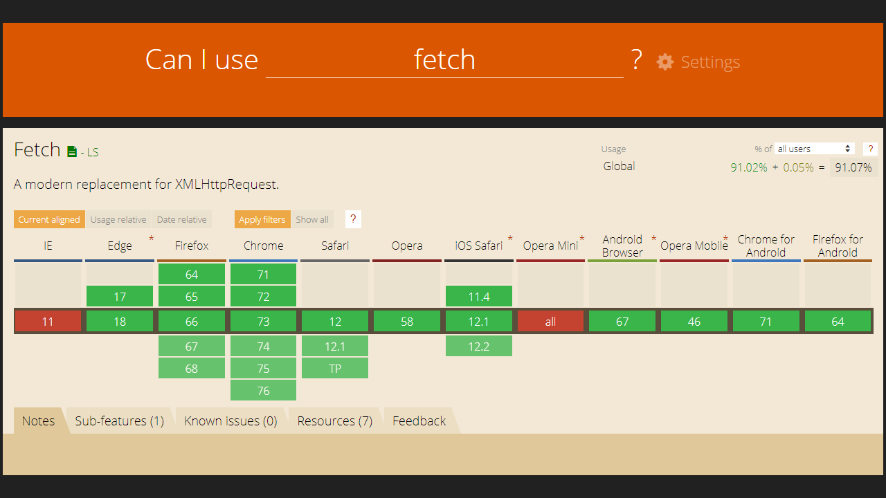

Slide 4
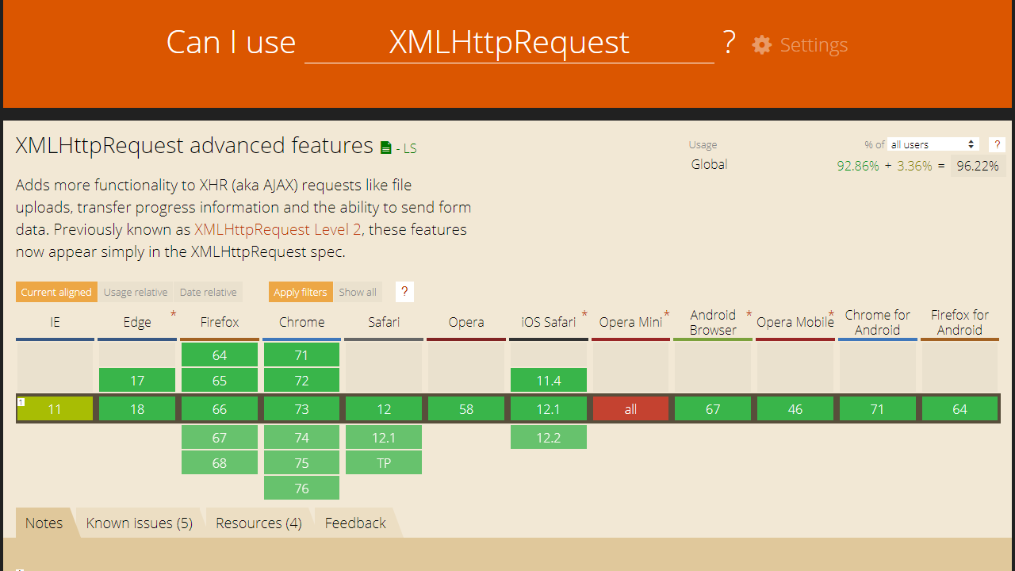

Slide 5
Get Request

Slide 6
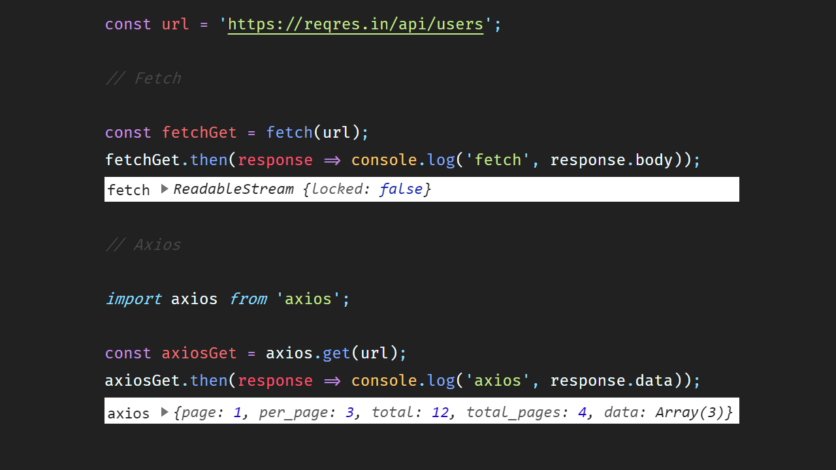

Slide 7
Streaming

Slide 8
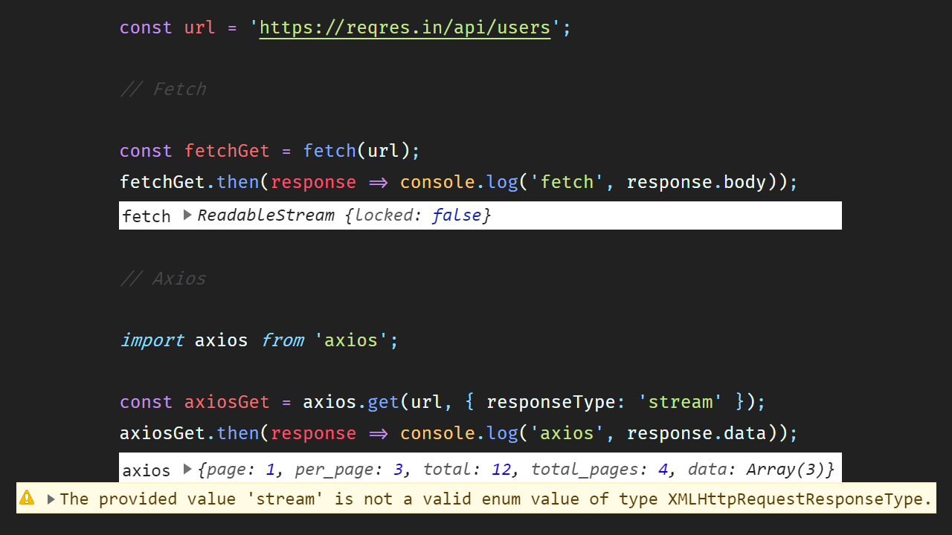

Slide 9
CORS

Slide 10
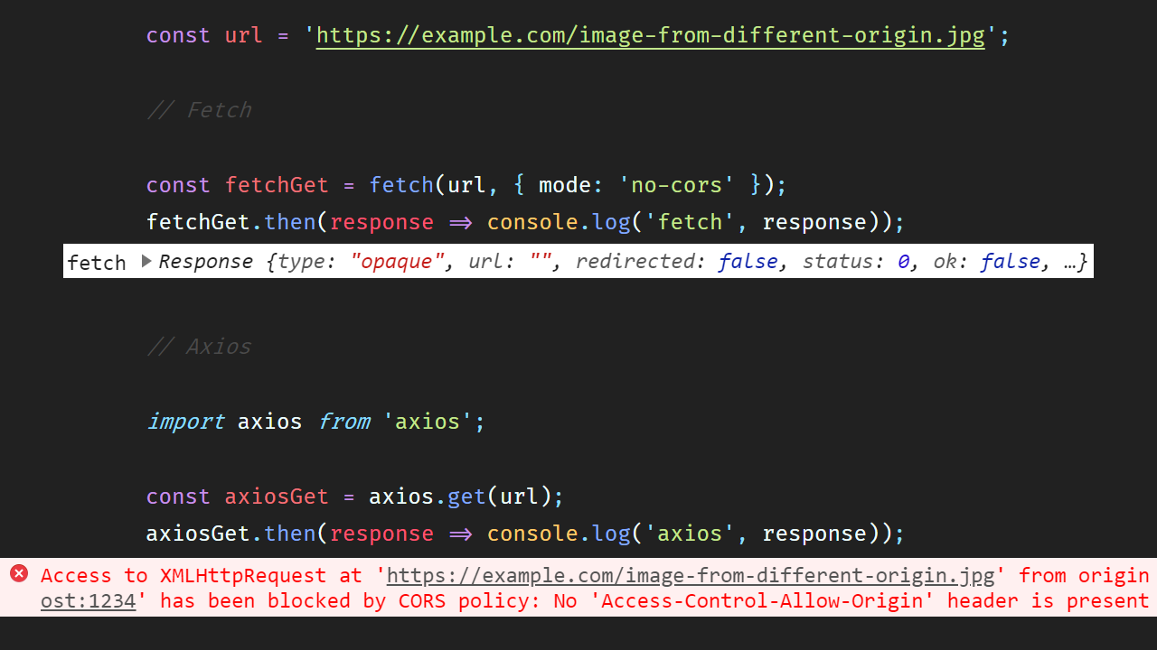

Slide 11
Response (JSON)

Slide 12
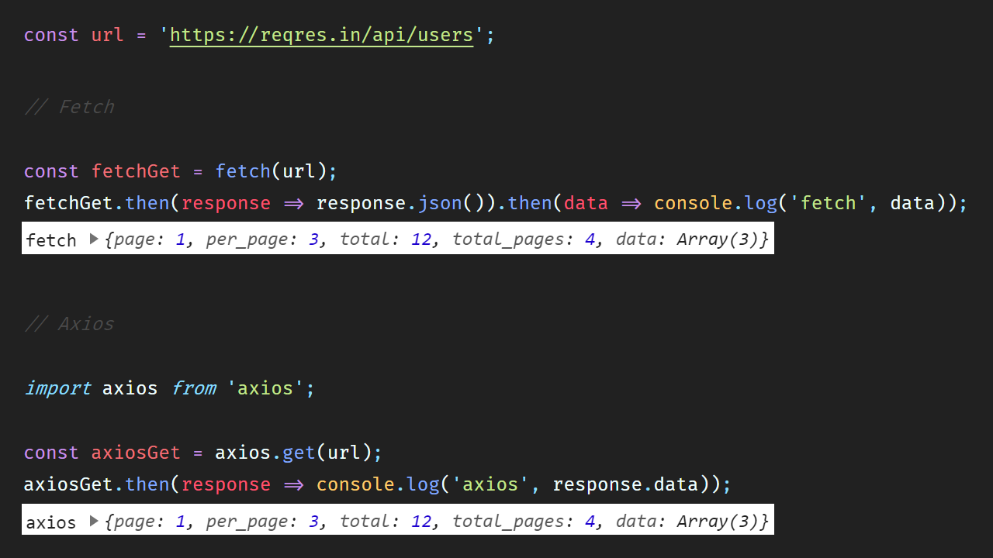

Slide 13
Post Request

Slide 14
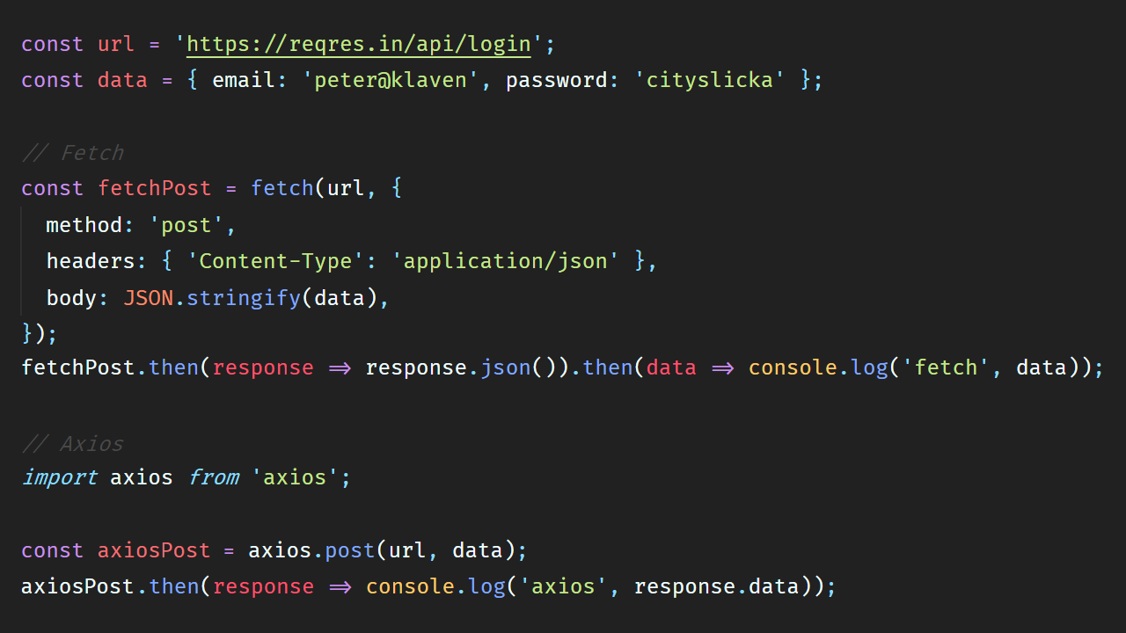

Slide 15
Response Errors (400-599)

Slide 16
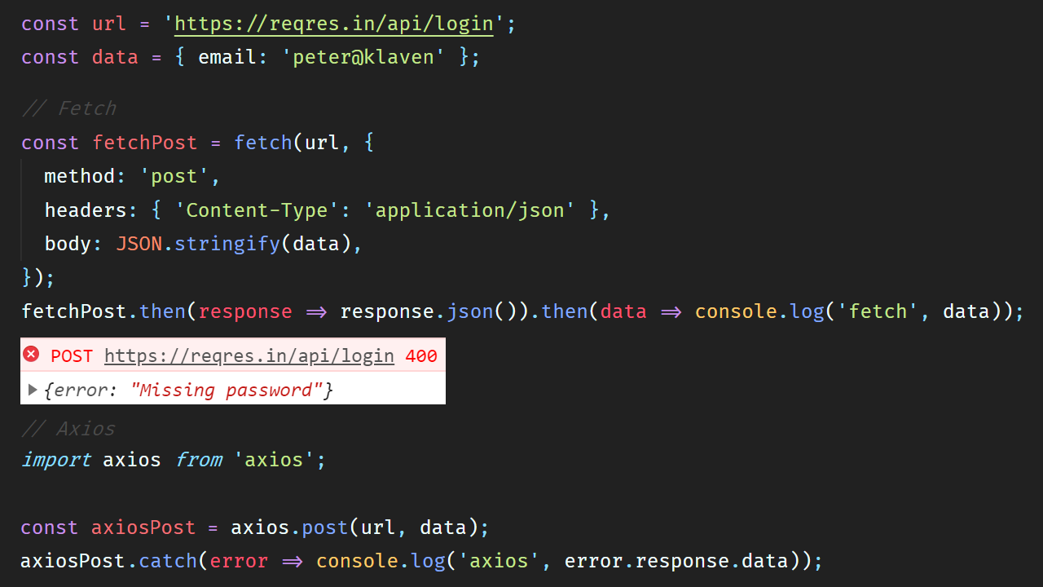

Slide 17
Workaround

Slide 18
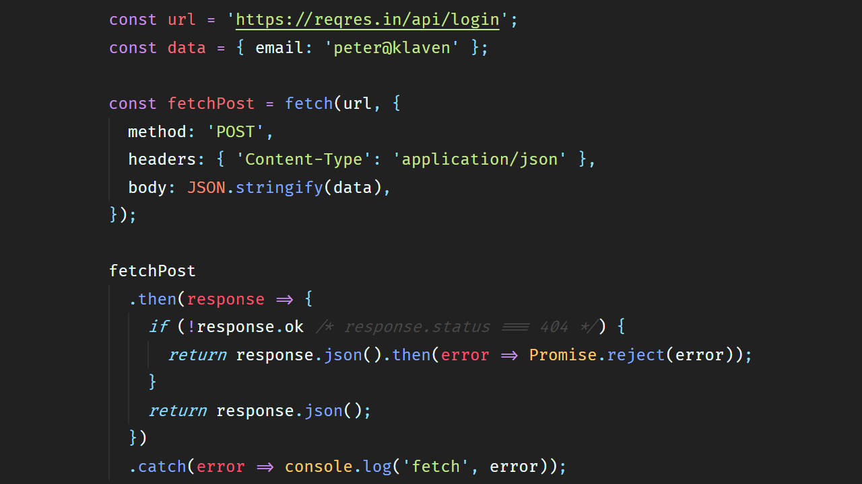

Slide 19
Network Errors

Slide 20
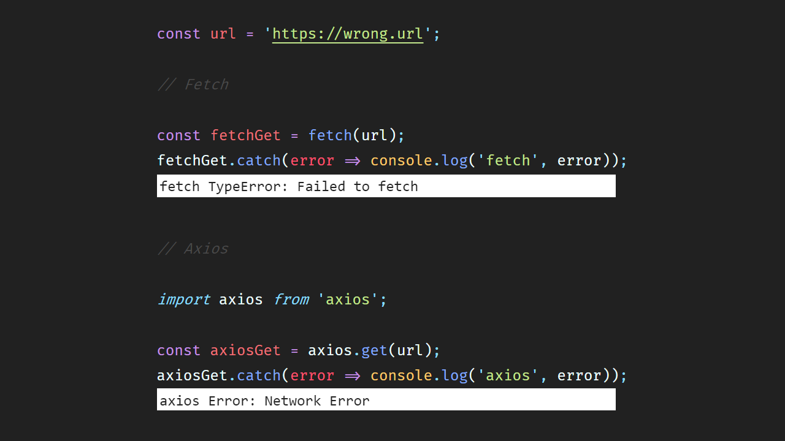

Slide 21
Canceling Request

Slide 22
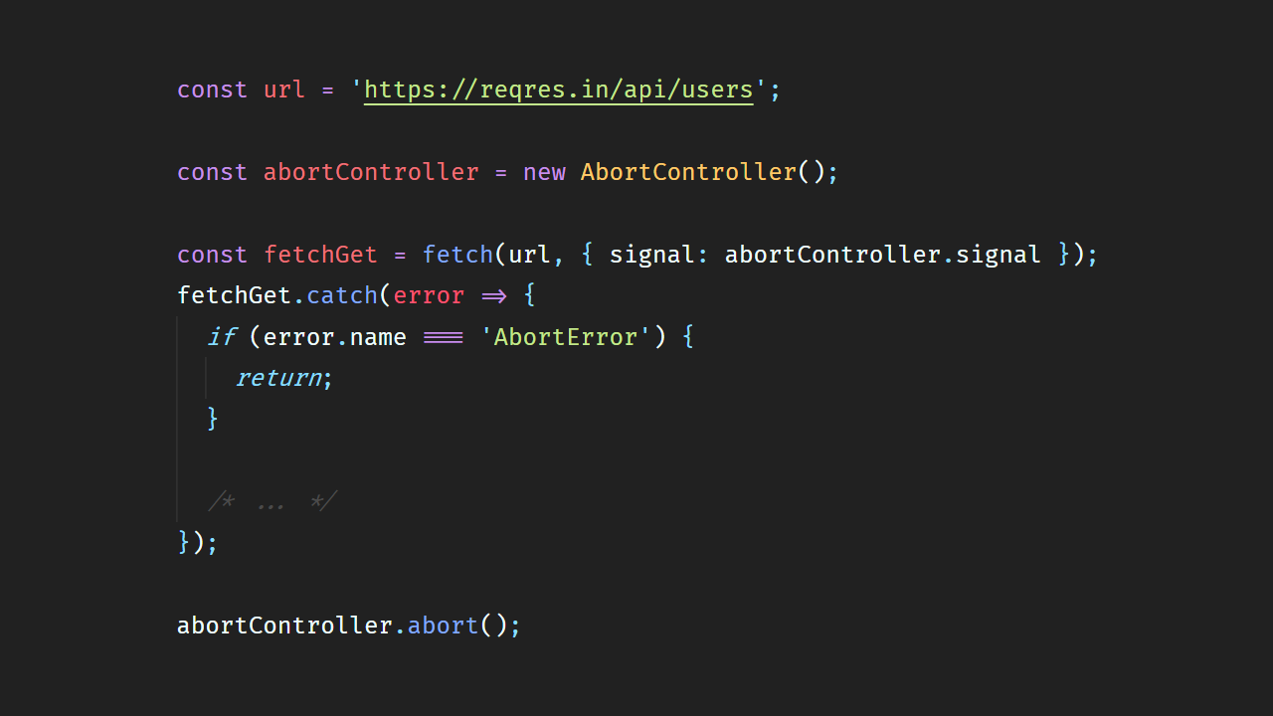

Slide 23
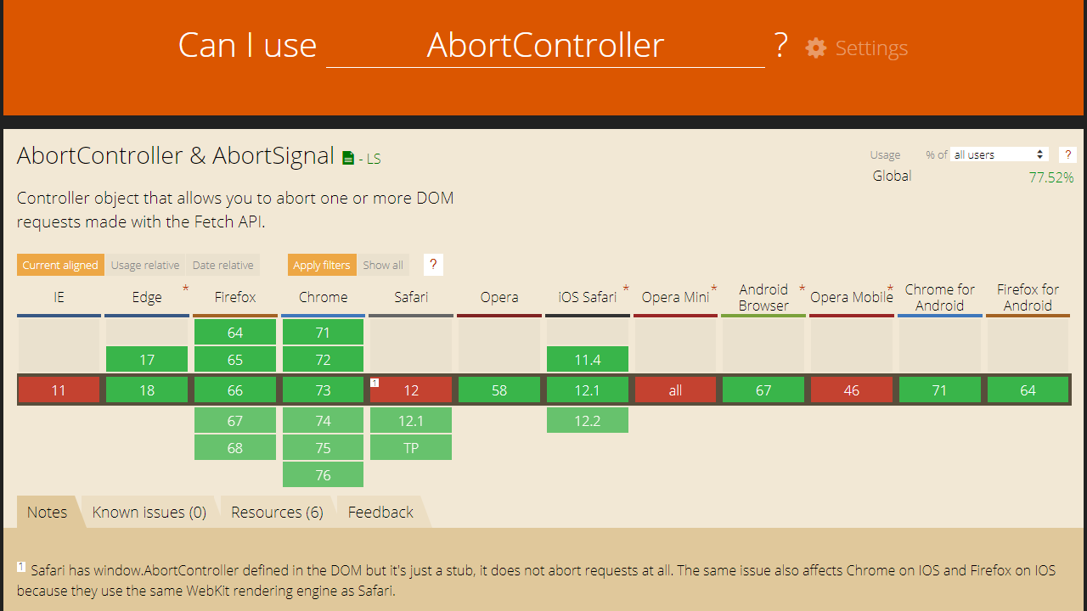

Slide 24
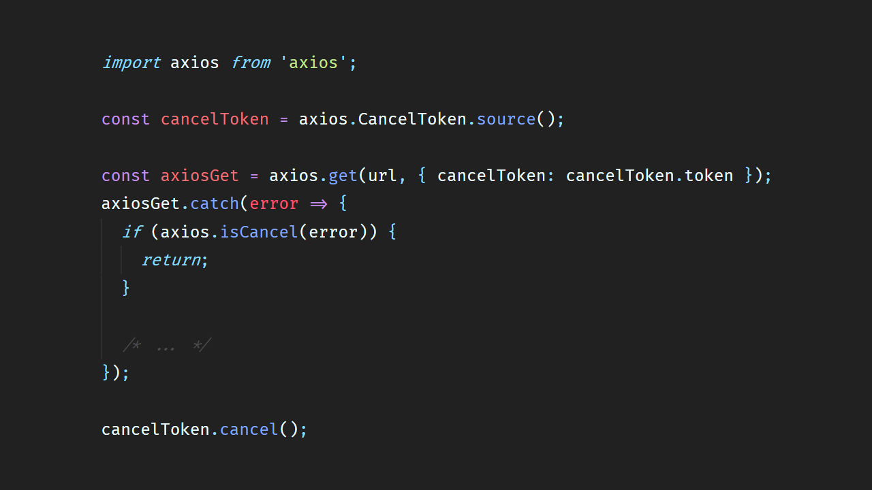

Slide 25
Timeout

Slide 26
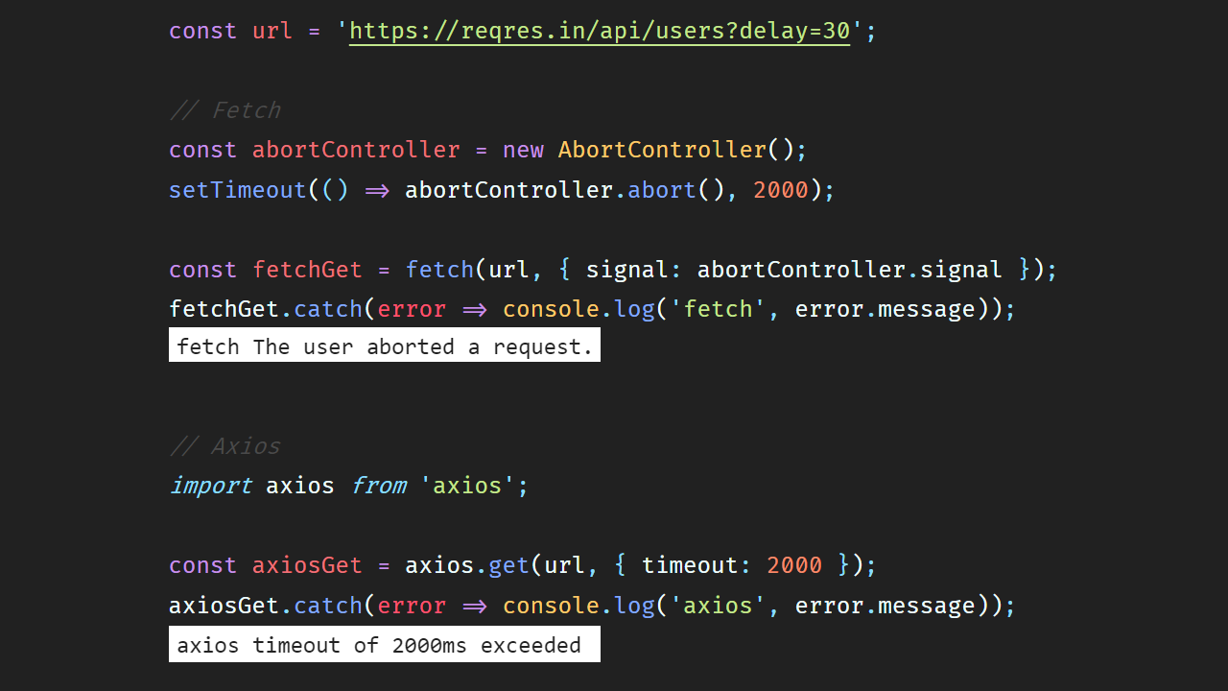

Slide 27
Wnioski

Slide 28
Fetch
PWA, Service Workers
Streaming
Własne reguły błędów
Axios
Upload progress (XHR)
OOTB Ready

Slide 29
Pytania?

Slide 30
Dzięki!

